Slide 1
REDUNDANCY REDUCTION IN FACE RECOGNITION USING SSD
THIRD REVIEW
Guided By,
Mr.M.Vignesh,
Assistant Professor,
Department of Artificial Intelligence and Data Science,
Karpagam Institute of Technology,
Coimbatore.
Presented by
S.DHANUSH(721220243010)
V.KISHOR KUMAR(721220243027)
S.LINKEDH (721220243028)
S.VIMAL(721220243062)
Department of Artificial Intelligence and Data Science,
Karpagam Institute of Technology,
Coimbatore.

Slide 2
Outline
Abstract
Module Description and Implementation
Module Diagrams (DFD)
Algorithm Explanations
Project Screen Shots and Demo
Publication Details
International Conference
International Journal
References

Slide 3
ABSTRACT
The Proposed system improved Viola-Jones face detection using Single Shot Detector Algorithm in order to reduce the redundancy rates. Viola-Jones ' s algorithm has succeeded in determining the best face scale factor, but it produces a non-comparable face window that leads the redundant face detection.
Facial recognition uses Computer-generated filters to transform face images into numerical expressions that can be compared to determine their similarity.
Single Shot Detection algorithm significantly faster in speed and high-accuracy object detection algorithm. It exibits small convolutional filters to predict object classes and offsets to default boundary boxes.

Slide 4
LIST OF MODULES
The Face Detector
(Module 1)
Data Scraping
(Module 2)
The Recognizer
(Module 3)

Slide 5

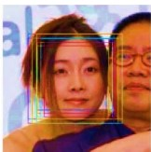
MODULE 1
THE FACE DETECTOR
Existing Method
The Existing Algorithm have the low Detection of the faces.
It also Detect the face redundantly which may cause inaccuracy in the result.

Slide 6
The Face Detector
Faces are made of thousands of fine lines and features that must be matched.
The Face Recognition using Python, break the task of identifying the face into thousands of smaller, bite-sized tasks.
The Main objective of facial recognition is to identify individuals, whether individually or collectively.

Slide 7

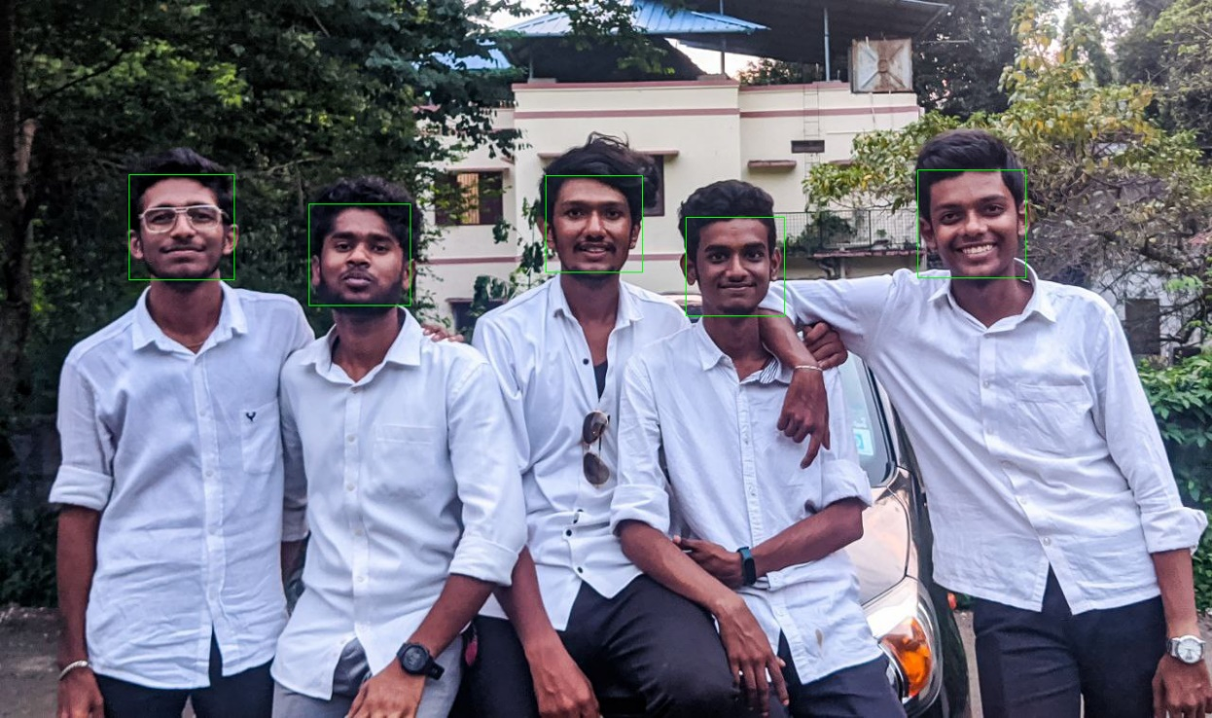
Face Detector – Implementation / Results
Input
Output

Slide 8

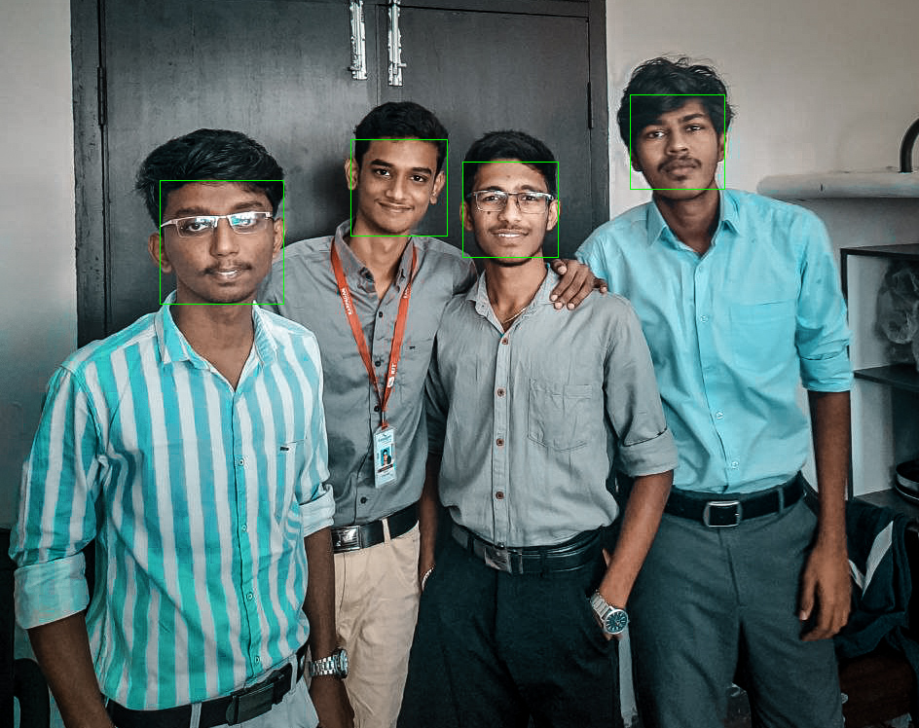
Face Detector – Implementation / Results
Input
Output

Slide 9
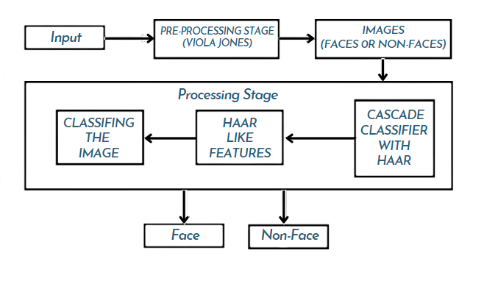
Face Detector – Data Flow Diagram

Slide 10


Face Detector – Screen Shots

Slide 11
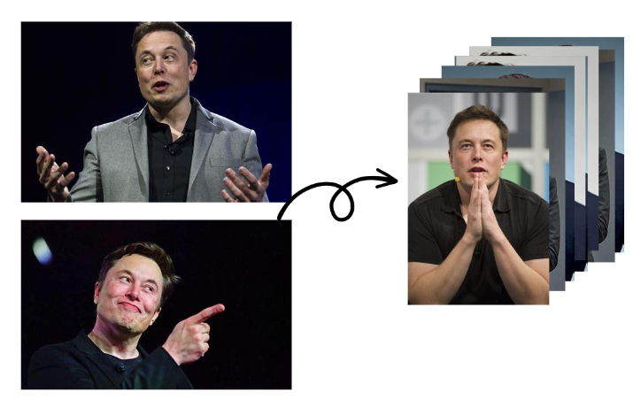
MODULE 2
DATA SCRAPING

Slide 12
Data Scraping
Data collection for facial recognition falls under image data collection and involves gathering face images to train.
Face images are taken of different people, annotated, and then fed into a machine learning model, which uses them to learn how to scan, identify and process facial features.
Data scraping involves pulling information out of a website.
It's completely legal to scrape publicly available data

Slide 13

Data Scraping – Implementation / Results

Slide 14
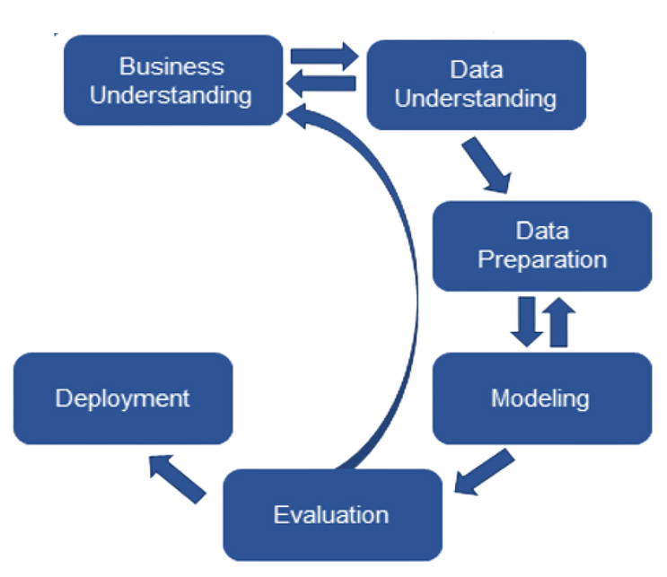
Data Scraping - Data Flow Diagram

Slide 15

Data Scraping - Screen Shots

Slide 16
Module 3
The Recognizer
A face recognizer is a computer program that uses biometric technology to identify or verify a person's identity based on their facial features.
It can be used for a variety of applications, including security and surveillance, personal identification, and access control.
The technology works by capturing an image of a person's face, analyzing it to extract unique facial features, and comparing it to a database of known faces to find a match.

Slide 17
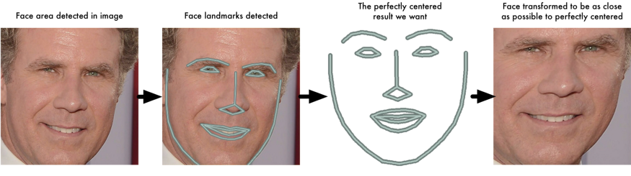
The Recognizer – Algorithm Implemented
A facial recognition system uses biometrics to map facial features from a photograph or video. It compares the information with a database of known faces to find a match.
It requires only a limited amount of data for encoding the faces.

Slide 18

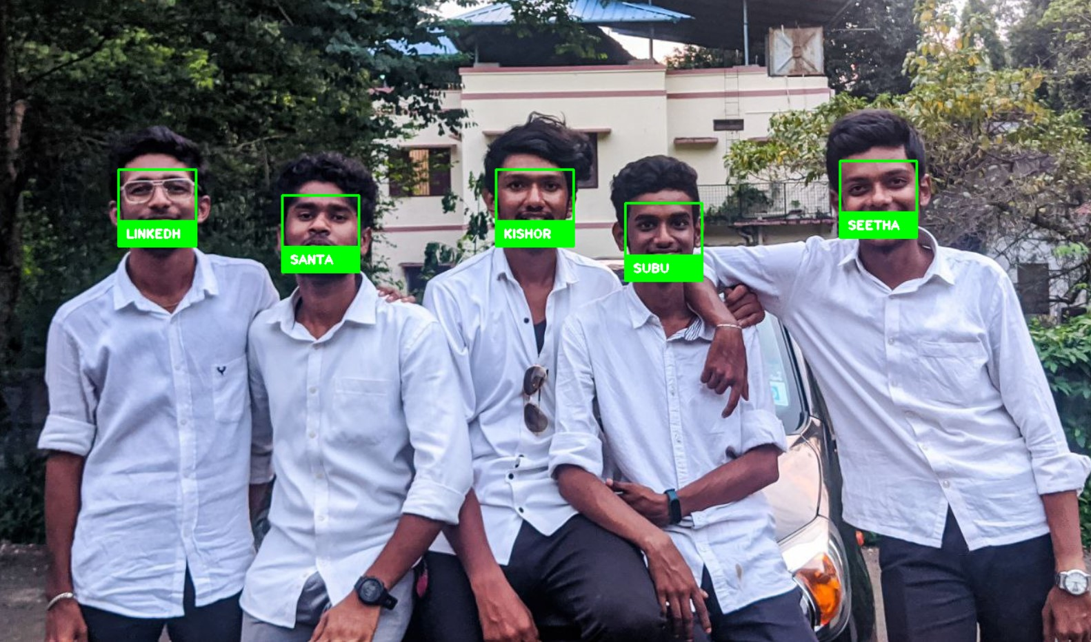
The Recognizer– Implementation / Results
Input
Output

Slide 19
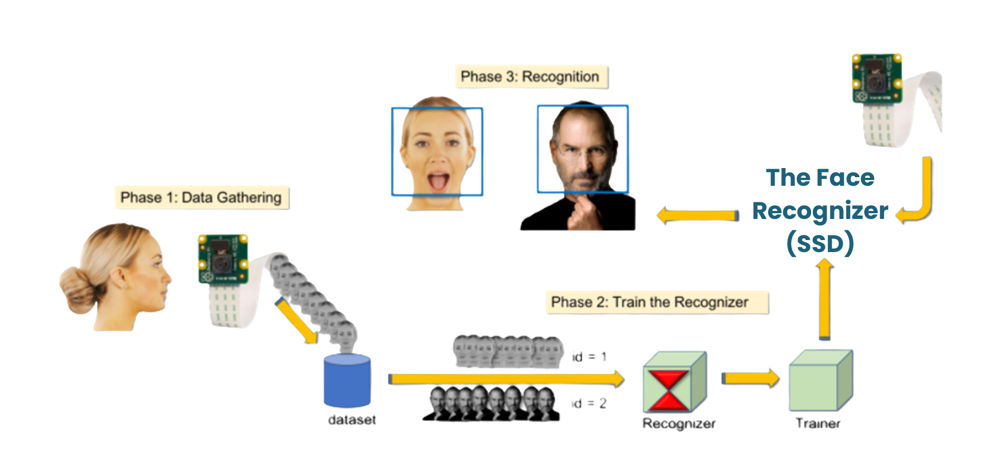
The Recognizer – Data Flow Diagram

Slide 20
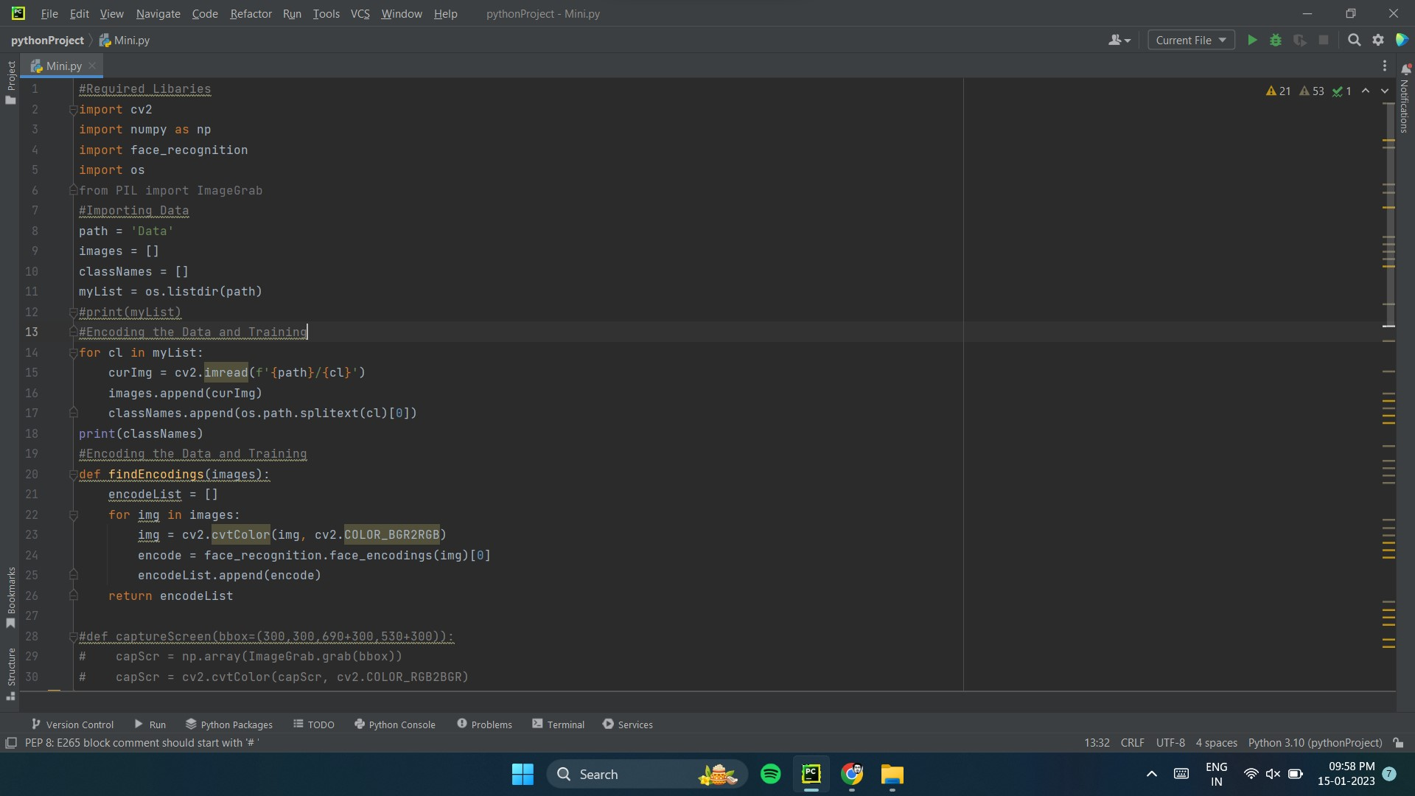
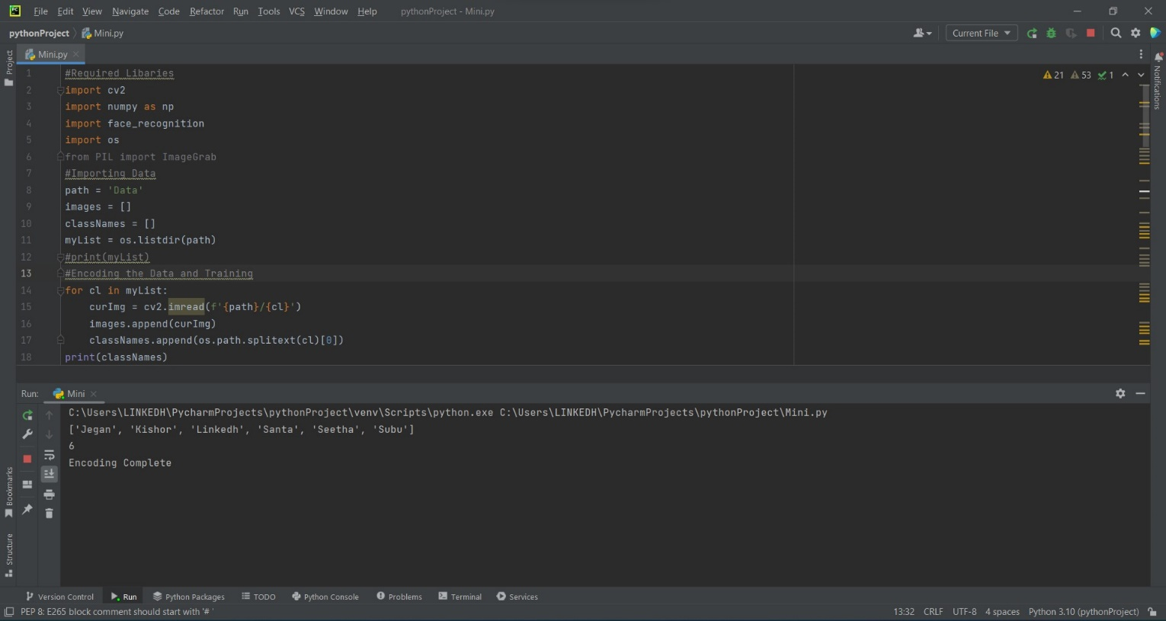
The Recognizer - Screen Shots

Slide 21
Publications
International Journal
International Conference

Slide 22
References
Journal Paper References
Base Paper
Reference Papers
Web References
(Times – 16 points / Italic)

Slide 23
Thank You!

